Slide 1
9 Admissions Legislation is NOT law
What is legislation then?
Primary legislation =
Instruments created by Parliament Assembled =
statute law
Secondary legislation derives its authority from primary legislation

Slide 2
9 Admissions Legislation is NOT law
1 – The Bill of Rights 1688
2 – Crown and Parliament Recognition Act 1689
3 – Primary legislation is ‘Statute ‘ law.
4 – Law must be rational = Impact assessment.
5 – Acts of Parliament are policy
6 – ‘Acts of Parliament’ = common law contract.
7 – Secondary legislation is agency law, subject to primary legislation.
8 – Case law = ‘force of law’
9 – Boris Johnson prorogation judgement 2019.

Slide 3
9 Admissions Legislation is NOT law
It is common sense that legislation is not law as:
To lie is to go against the mind.
Ignorance of the law is no excuse.
All are equal under the law.
No one is above the law.

Slide 4
9 Admissions Legislation is NOT law
Sir William Blackstone, reasoned:
"For as God, when he created matter, and endued it with a principle of mobility, established certain rules for the...direction of that motion;

Slide 5
9 Admissions Legislation is NOT law
Sir William Blackstone, reasoned:
“so, when he created man, and endued him with freewill to conduct himself in all parts of life, he laid down certain immutable laws of human nature, whereby that freewill is in some degree regulated and restrained, and gave him also the faculty of reason to discover the purport of those laws.”

Slide 6
9 Admissions Legislation is NOT law
What are those natural laws? Blackstone continued:
"Such among others are these principles:
that we should live honestly,
should hurt nobody, and
should render to every one his due.."

Slide 7
9 Admissions Legislation is NOT law
Bill of Rights 1688
This is the source authority of those governing today, and sets out the legal contract between those governing, and the governed.
It is dealt with in detail in a separate presentation, but for this purpose only limited points will be used.

Slide 8
9 Admissions Legislation is NOT law
Bill of Rights 1688
The lawful claim of subject’s (human) rights is expressed as
‘... the best meanes for attaining the Ends aforesaid Doe in the first place (as their Auncestors in like Case have usually done) for the Vindicating and Asserting their auntient Rights and Liberties,..’

Slide 9
9 Admissions Legislation is NOT law
Bill of Rights 1688
Under the acceptance of the offer to contract the power of those governing was constrained to uphold humans inalienable rights and expresses:
‘... that noe Declarations Judgements Doeings or Proceedings to the Prejudice of the People in any of the said Premisses ought in any wise to be drawne hereafter into Consequence or Example...’

Slide 10
9 Admissions Legislation is NOT law
Bill of Rights 1688
‘... Now in pursuance of the Premisses the said Lords Spirituall and Temporall and Commons in Parlyament assembled for the ratifying confirming and establishing the said Declaration and the Articles Clauses Matters and Things therein contained by the Force of a Law made in due Forme by Authority of Parlyament... ‘

Slide 11
9 Admissions Legislation is NOT law
Bill of Rights 1688
‘... doe pray that it may be declared and enacted That all and singular the Rights and Liberties asserted and claimed in the said Declaration are the true auntient and indubitable Rights and Liberties of the People of this Kingdome and...’

Slide 12
9 Admissions Legislation is NOT law
Bill of Rights 1688
‘... soe shall be esteemed allowed adjudged deemed and taken to be and that all and every the particulars aforesaid shall be firmly and strictly holden and observed as they are expressed in the said Declaration...’

Slide 13
9 Admissions Legislation is NOT law
Bill of Rights 1688
‘...And all Officers and Ministers whatsoever shall serve their Majestyes and their Successors according to the same in all times to come...’

Slide 14
9 Admissions Legislation is NOT law
Bill of Rights 1688
Affirming the legality of replacing those governing when they no longer are fit for purpose, in line with Sir William Blackstone’s reasoning as this being a natural inalienable right, and that those governing are bound by contract to the governed.

Slide 15
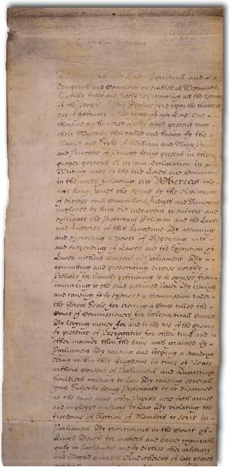
9 Admissions Legislation is NOT law
Bill of Rights 1688
Anything standing prior to this authority has no legal standing, unless so authorised by Parliament Assembled
(e.g. Magna Carta 1215 has no legal standing, but Magna Carta 1297 does have legal standing).

Slide 16
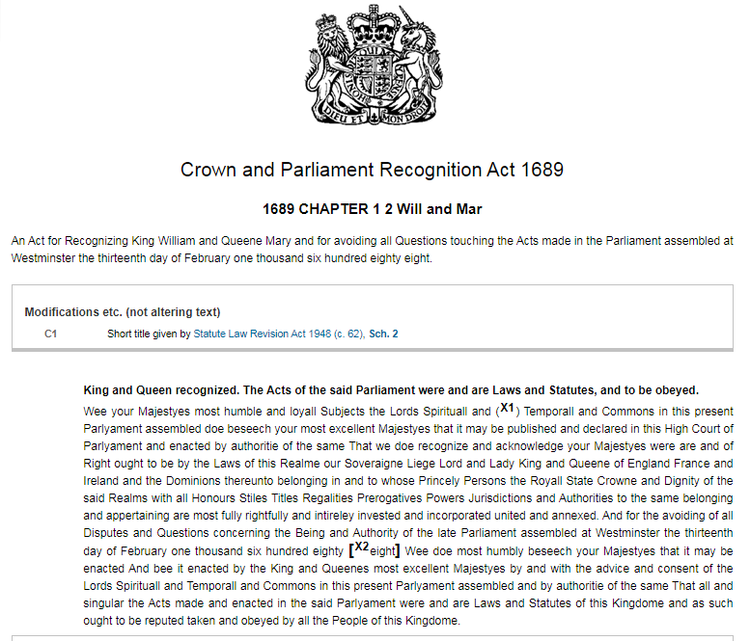
9 Admissions Legislation is NOT law
Crown and Parliament Recognition Act 1689

Slide 17
9 Admissions Legislation is NOT law
Crown and Parliament Recognition Act 1689
Last sentence
‘...That all and singular the Acts made and enacted in the said Parlyament were and are Laws and Statutes of this Kingdome and as such ought to be reputed taken and obeyed by all the People of this Kingdome.’

Slide 18
9 Admissions Legislation is NOT law
Crown and Parliament Recognition Act 1689
‘as such ought to be’
is nothing more than advice and guidance

Slide 19
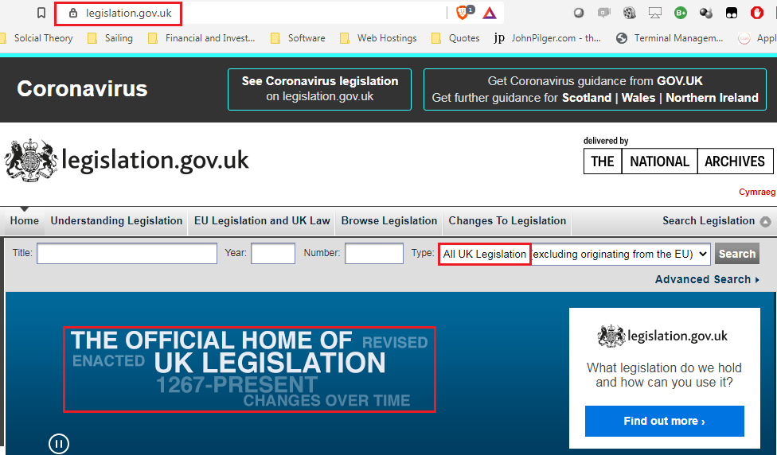
9 Admissions Legislation is NOT law

Slide 20
9 Admissions Legislation is NOT law
There are only 2 types of legislation
Primary legislation
Secondary legislation

Slide 21
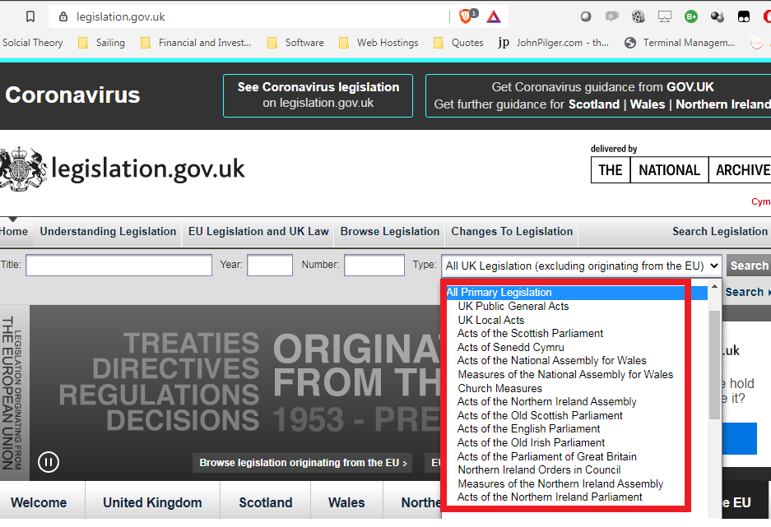
9 Admissions Legislation is NOT law
Primary legislation

Slide 22
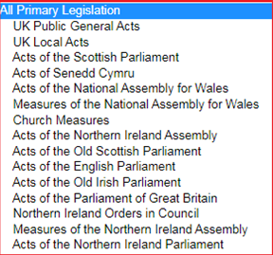
9 Admissions Legislation is NOT law
Primary legislation

Slide 23
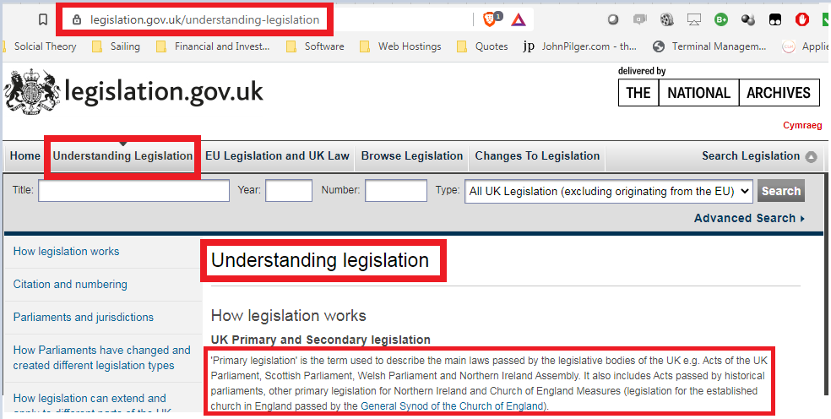
9 Admissions Legislation is NOT law
Primary legislation

Slide 24
9 Admissions Legislation is NOT law
Primary legislation
'Primary legislation' is the term used to describe the main laws [later defined as ‘Statute’ Law] passed by the legislative bodies of the UK e.g.

Slide 25
9 Admissions Legislation is NOT law
Primary legislation
...Acts of the UK Parliament, Scottish Parliament, Welsh Parliament and Northern Ireland Assembly.

Slide 26
9 Admissions Legislation is NOT law
Primary legislation
...It also includes Acts passed by historical parliaments, other primary legislation for Northern Ireland and Church of England Measures (legislation for the established church in England passed by the General Synod of the Church of England).

Slide 27
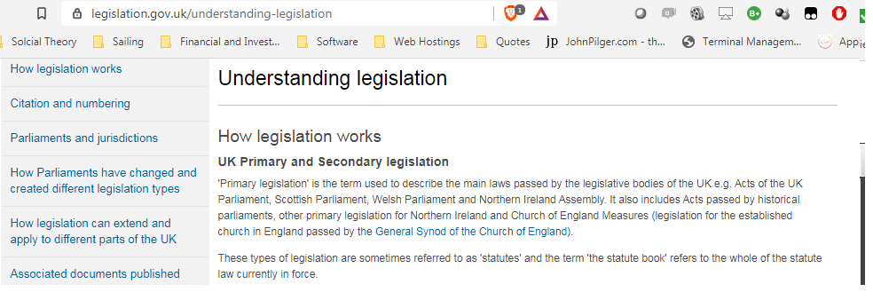
9 Admissions Legislation is NOT law
Primary legislation

Slide 28
9 Admissions Legislation is NOT law
Primary legislation
These types of legislation are sometimes referred to as 'statutes' and the term 'the statute book' refers to the whole of the statute law currently in force.
By admission: Primary Legislation = Statute Law

Slide 29
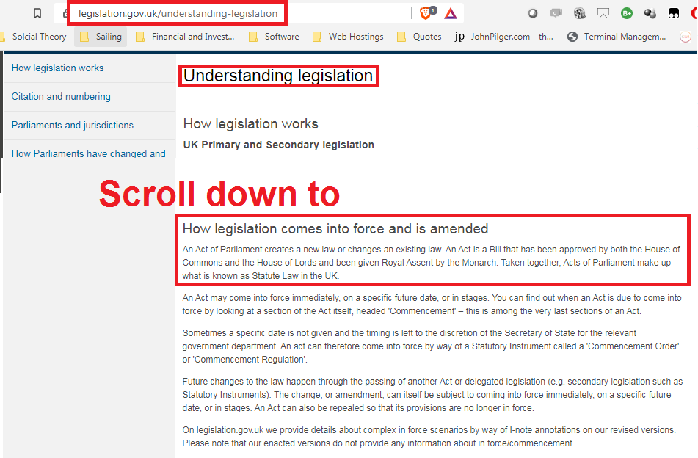
9 Admissions Legislation is NOT law
Primary legislation

Slide 30
9 Admissions Legislation is NOT law
Primary legislation
Taken together, Acts of Parliament make up what is known as Statute Law in the UK.
Reaffirming: Primary Legislation = Statute Law

Slide 31
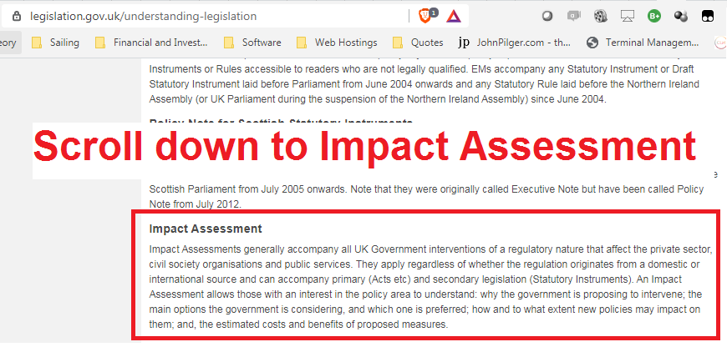
9 Admissions Legislation is NOT law
    Rationality is admitted to be a requirement on legislation.gov.UK

Slide 32
9 Admissions Legislation is NOT law
    Rationality is admitted to be a requirement on legislation.gov.UK
    An Impact Assessment allows those with an interest in the policy area to understand:
Policy is not law

Slide 33
9 Admissions Legislation is NOT law
    Rationality is admitted to be a requirement on legislation.gov.UK
    why the government is proposing to intervene;
    the main options the government is considering, and
    which one is preferred;

Slide 34
9 Admissions Legislation is NOT law
    Rationality is admitted to be a requirement on legislation.gov.UK
    how and to what extent new policies may impact on them; and,
    the estimated costs and benefits of proposed measures.

Slide 35
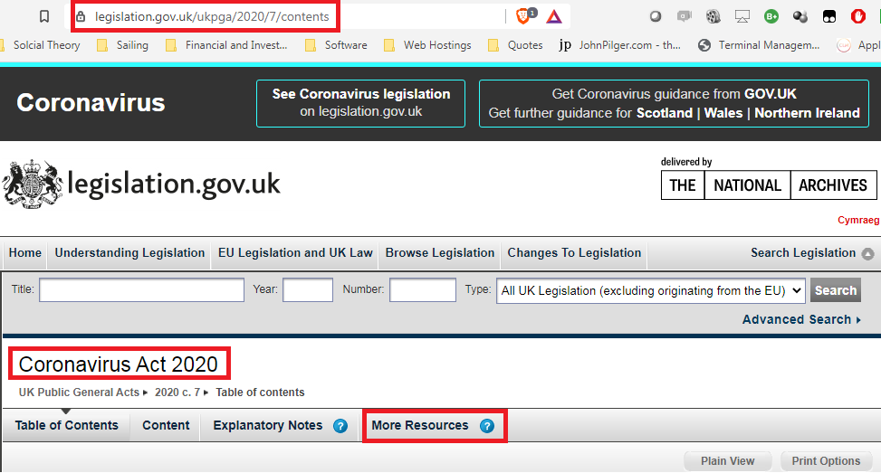
9 Admissions Legislation is NOT law
    Rationality is admitted to be a requirement on legislation.gov.UK

Slide 36
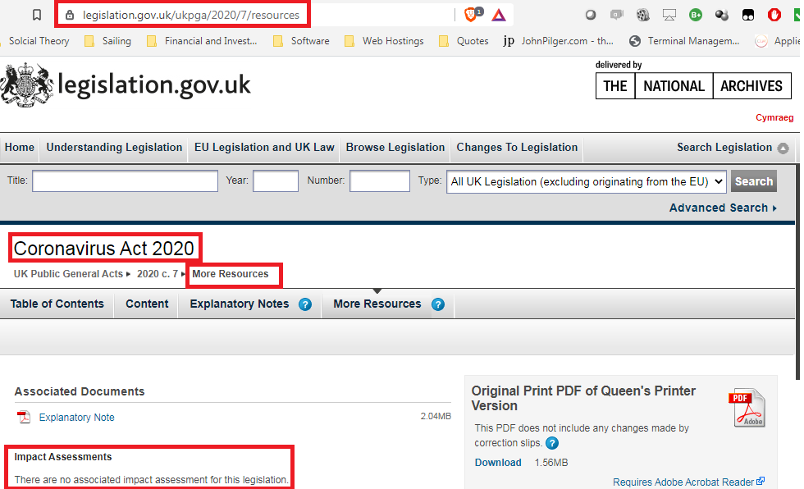
9 Admissions Legislation is NOT law
    Rationality is admitted to be a requirement on legislation.gov.UK

Slide 37
9 Admissions Legislation is NOT law
    If there is no impact assessment then it cannot be lawful, but merely advice and guidance
    If there is an impact assessment then it must be verified to be rational.
    Rational means:
    Legislation has a legitimate aim, and
    Cause and options are logical and rational, and
    Chosen action causes least impact on society = reasonableness
    Failure on any of these measures removes the force of law!

Slide 38
9 Admissions Legislation is NOT law
Primary legislation
Time to hold MP’s to account as they claim
‘It is the Government’
Is totally without merit.
As creators of Acts of Parliament,
By their very same authority can uncreate!
By amendments or repeals

Slide 39
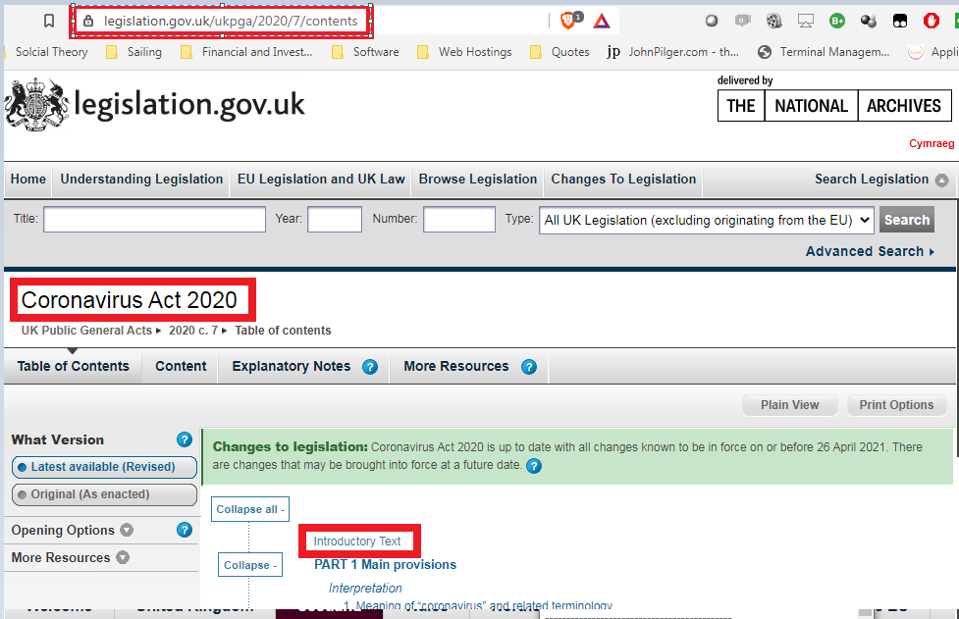
9 Admissions Legislation is NOT law
Primary legislation = Common law Contract

Slide 40
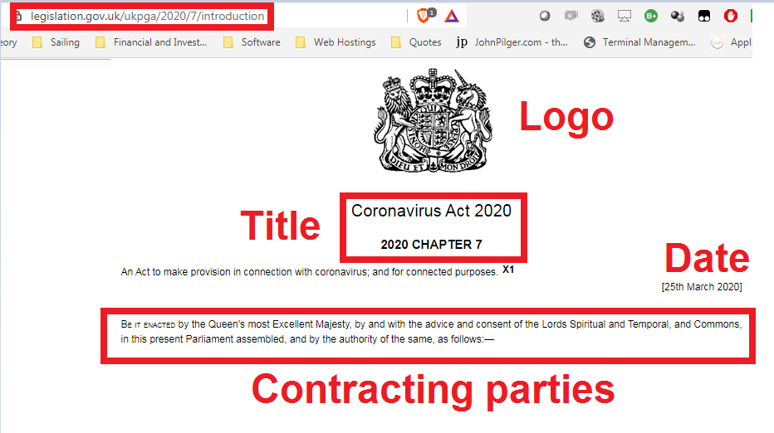
9 Admissions Legislation is NOT law
Primary legislation = Common law Contract

Slide 41
9 Admissions Legislation is NOT law
Primary legislation = Common law Contract
The Contracting Parties
Be it enacted by the Queen's most Excellent Majesty,
by and with the advice and consent of
the Lords Spiritual and Temporal, and Commons,
in this present Parliament assembled,
and by the authority of the same, as follows

Slide 42
9 Admissions Legislation is NOT law
Primary legislation = Common law Contract
Capacity and consent
Be it enacted by the Queen's most Excellent Majesty,
by and with the advice and consent
of the Lords Spiritual and Temporal, and Commons,
in this present Parliament assembled,
and by the authority of the same, as follows

Slide 43
9 Admissions Legislation is NOT law
Primary legislation = Common law Contract
by and with the advice and consent
= meeting of minds
by the authority of the same
= self proclaimed authority creating capacity
CREATES COMMON LAW CONTRACT

Slide 44
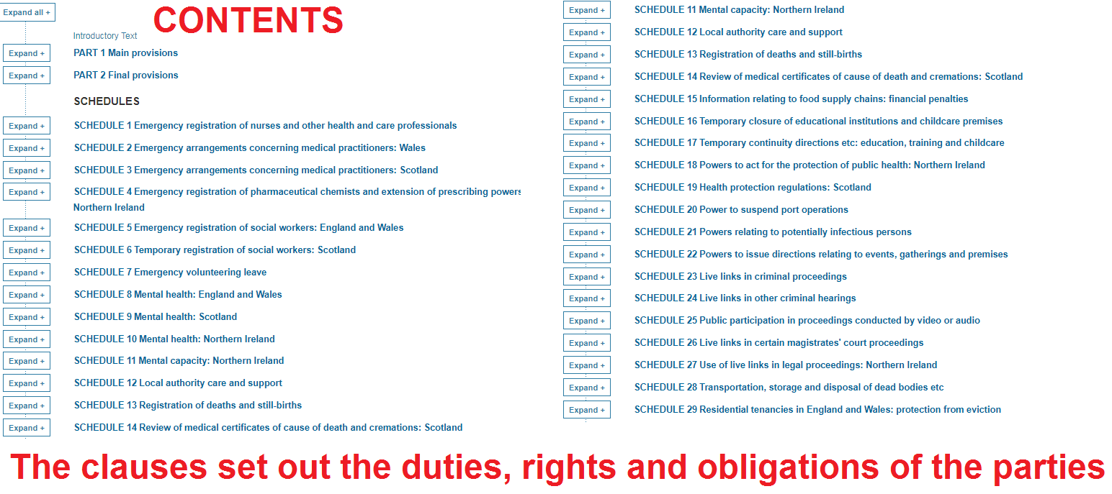
9 Admissions Legislation is NOT law
Primary legislation = Common law Contract

Slide 45
9 Admissions Legislation is NOT law
Primary legislation = Common law Contract
Primary legislation is merely a Common Law Contract created by the consenting parties, which limits its force of law to those contracting parties and no further!

Slide 46
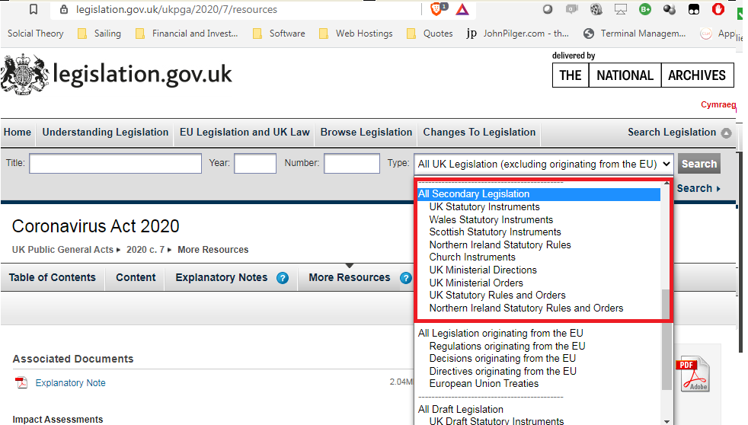
9 Admissions Legislation is NOT law
Secondary legislation

Slide 47
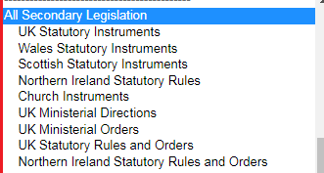
9 Admissions Legislation is NOT law
Secondary legislation

Slide 48
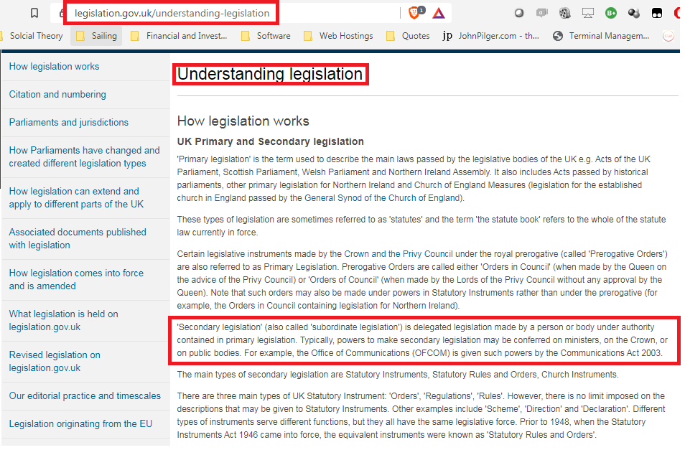
9 Admissions Legislation is NOT law
Secondary legislation

Slide 49
9 Admissions Legislation is NOT law
Secondary legislation = Agency
'Secondary legislation' (also called 'subordinate legislation') is delegated legislation made by a person or body under authority contained in primary legislation. Typically, powers to make secondary legislation may be conferred on ministers, on the Crown, or on public bodies.

Slide 50
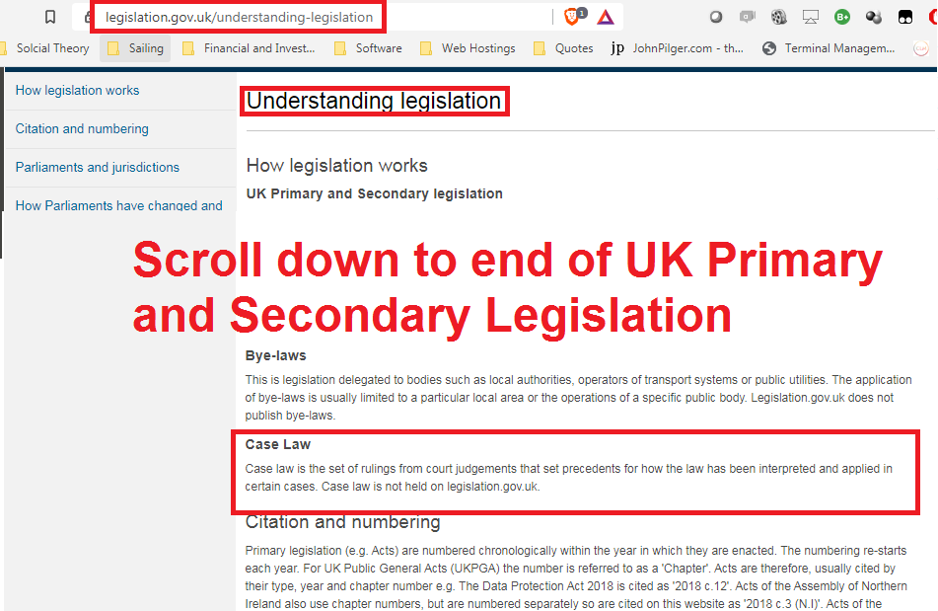
9 Admissions Legislation is NOT law
Case Law

Slide 51
9 Admissions Legislation is NOT law
Case Law
Case law is the set of rulings from court judgements that set precedents for how the law has been interpreted and applied in certain cases. Case law is not held on legislation.gov.uk.

Slide 52
9 Admissions Legislation is NOT law
Case Law = Common Law Precedence
So if there is no case law,
then an Act of Parliament by admission, and hence it is not disputed,
has no force of law,
as again confirmed in Understanding Legislation on Legislation.gov.UK

Slide 53
9 Admissions Legislation is NOT law
THE 2019 BORIS PROROGATION CASE WAS A TIFF BETWEEN PARLIAMENT AND HM
GOVERNMENT AS TO WHO IS THE BOSS:
In the unanimous 11 judge Supreme Court ruling in
R (Miller) v The Prime Minister and
Cherry v Advocate General for Scotland ([2019] UKSC 41)

Slide 54
9 Admissions Legislation is NOT law
It turns out both Parliament and HM Government were wrong.
The people are the boss, and it has been this way for centuries!!!

Slide 55
9 Admissions Legislation is NOT law
This judgement reaffirmed the peoples remedy is NOT to go crying to the pretend commissions or complaints procedures those governing provide to make you feel like you have justice...

Slide 56
9 Admissions Legislation is NOT law
FURTHER,
The judgement further affirms
ONLY HM GOVERNMENT, AND
IT’S AGENTS,
ARE SUBJECT TO ACTS OF PARLIAMENT,
being the instruments used by Parliament to express it’s will!

Slide 57
9 Admissions Legislation is NOT law
The peoples remedy is found in the INDEPENDANT JUDICIARY,
and
It is high time we start doing that!!!

Slide 58
9 Admissions Legislation is NOT law
    For anything to be law, it must be rational
    Allegedly distinguishes humans from animals
    under the binding precedence of Council of Civil Service Unions v Minister for the Civil Service [1985] AC 374, Lord Diplock said that a decision would be

Slide 59
9 Admissions Legislation is NOT law
    'IRRATIONAL- AND SO UNLAWFUL'
    ‘...if it were so outrageous in its defiance of logic or of accepted moral standards
    that no sensible person who had applied his mind to the question to be decided could have arrived at it.”

Slide 60
9 Admissions Legislation is NOT law
APPLYING LOGIC AND REASON
test this evidence to an extreme...
If for some unknown reason Parliament Assembled enacted:
All must jump off the cliffs of Dover...
Would that be law???

Slide 61
9 Admissions Legislation is NOT law
Obviously that would not be law...
AFFIRMING...
1 - Legislation is merely advice and guidance to deliver the obligations of those governing,
2 - Common law precedence is created in HM Courts,
3 - Lawful excuse to existing common law is argued under the rules of equity which express natural law, and
4 – THOSE GOVERNING ARE SUBJECT TO THE LAW!
TIME TO ADDRESS THE ELEPHANT IN THE ROOM!

Slide 62
9 Admissions Legislation is NOT law
LEGISLATION IS MERELY THE NAME OF THE INSTRUMENTS USED BY THOSE GOVERNING TO
DELIVERY THEIR OBLIGATIONS
AS SET OUT IN THE BILL OF RIGHTS 1688
TO THE PEOPLE,
WHO HOLD THOSE GOVERNING TO ACCOUNT IN THE INDEPENDANT JUDICIARY,
THEREBY CREATING THE COMMON LAW,
BY THE PEOPLE, UNDER THE RULES OF EQUITY!

Slide 63
9 Admissions Legislation is NOT law
LEGISLATION = ADMINISTRATIVE LAW
with limited jurisdiction to the contracting parties obliged to deliver equitable obligations of the people natural human rights, including removal of those governing when they no longer are fit for purpose!

Slide 64
9 Admissions Legislation is NOT law
Much confusion has been created by enacting some common law into Acts of Parliament (codified common law),
And a false belief by those governing that they are above the law as they create the law!

Slide 65
9 Admissions Legislation is NOT law
UPHOLDING AND AFFIRMING:
Ignorance of the law is no excuse,
To lie is to go against the mind,
All are equal under the law,
No one is above the law,
The law operates without fear or favour,
Innocent until proven guilty.

